Slide 1
RESEARCH PROPOSAL · AI & COMPUTER VISION
What Makes AI-Based Sparse-View 3D Gaussian Splatting Work?
Separating the roles of predicted camera poses, predicted 3D points and pose refinement
Farida Gaber · Mona Yasser
Supervisor: Dr. Wedad Sallam
November 2026
Notes:
Introduce yourselves and the topic in one sentence: this project studies why AI-based methods can build 3D scenes from only a few photos, by testing which part of the method actually creates the quality. It is an AI and computer vision project, not an AR/MR application.

Slide 2
BACKGROUND
What is 3D Gaussian Splatting (3DGS)?
STEP 1
Photos + poses
Photos of one scene, each with its camera pose: where the camera stood and where it pointed.
STEP 2
Training
Millions of small 3D “blobs” (Gaussians) are optimized by gradient descent so their renders match the photos.
STEP 3
New views
The scene can be rendered in real time from viewpoints where no photo was taken.
For an AI researcher: it is an optimization problem. The parameters are each blob’s position, shape and colour; the loss is the difference between rendered and real photos.
Kerbl et al., SIGGRAPH 2023 · 2 / 15
Notes:
3DGS is the core technique. Explain it like training a model: we start with many small 3D blobs and use gradient descent so that rendering them from each camera reproduces the real photo. The key point for this project: step 1 needs the camera pose of every photo.

Slide 3
BACKGROUND
The camera pose problem
100+
photos: COLMAP works
COLMAP, the classic tool, matches points between overlapping photos and uses geometry to compute every camera pose.
3–9
photos: COLMAP often fails
With few photos there are too few matches, so poses are wrong or missing, and 3DGS cannot be trained well.
This is the sparse-view setting: building a 3D scene from only a few photos.
Sparse-View 3DGS Research Proposal · 3 / 15
Notes:
A camera pose is simply the position plus direction of the camera. COLMAP computes it from many photos. With only a few photos it often fails; InstantSplat's authors report that COLMAP fails with three views. This is the problem the field calls sparse-view reconstruction.

Slide 4
BACKGROUND
AI models now predict the poses directly
Classic: COLMAP
Hand-designed feature matching + geometry
Needs many overlapping photos
Minutes to hours per scene
AI: MASt3R, VGGT
Large pretrained transformers
Predict poses + dense 3D points
Work with 2–3 photos, in seconds
InstantSplat = AI poses + AI 3D points + pose refinement
MASt3R gives the start; poses are then corrected during 3DGS training. Under a minute for 3–12 photos.
Leroy et al., ECCV 2024 · Wang et al., CVPR 2025 · Fan et al., arXiv 2403.20309 · 4 / 15
Notes:
This is where our AI background fits. Foundation models like MASt3R and VGGT are transformers trained on large 3D datasets. InstantSplat combines three things: AI-predicted poses, AI-predicted 3D points, and refining the poses during training. Our project asks which of these three things really matters.

Slide 5
A HIDDEN ISSUE IN CURRENT RESEARCH
Many sparse-view papers train on 3–24 photos, but use camera poses computed from all 100–300 photos.
In a real few-photo situation, these all-photo poses are not available. So we do not know how much of the reported quality comes from the poses.
Raised by MS-GS, NeurIPS 2025 (arXiv 2509.15548) · 5 / 15
Notes:
This is the motivation. Methods like FSGS train with 24 photos, but their camera poses were computed by COLMAP from all photos in the dataset. The MS-GS paper at NeurIPS 2025 pointed this out. It means the camera poses may be doing a lot of the work, and nobody has measured how much.

Slide 6
LITERATURE REVIEW
The closest papers
Paper | What it does | Mip-NeRF 360 views | What is missing
VGGT-X (2025) | Tests 2 of our 3 switches | All (dense) | Dense views only
SPARS3R (2024) | COLMAP vs MASt3R points | One count | One view count only
SDI-GS (2025) | Same pipeline as InstantSplat | 3 / 6 / 12 | No separation of parts
InstantSplat (2025) | AI poses + points + refinement | Not benchmarked | No reference-pose test
Free360 (2025) | New method; InstantSplat baseline | 3 / 6 / 9 | No separation of parts
MS-GS (2025) | Realistic pose setting | 20 | One view count only
Pi-GS (2026) | π³ model initialization | 3 / 12 | No separation of parts
About 30 papers checked in detail, including all Elicit, Consensus and Perplexity results. Full list in the novelty-check report.
arXiv 2509.25191 · 2411.12592 · 2509.11853 · 2403.20309 · 2503.24382 · 2509.15548 · 2602.03327 · 6 / 15
Notes:
These are the six most relevant papers. InstantSplat is the method we build on. VGGT-X is now the closest: it tested pose refinement on/off and random vs AI points, but only with dense views. SPARS3R compared COLMAP points with MASt3R points at one view count. SDI-GS uses the same pipeline as InstantSplat but does not separate its parts. Free360 gives us the evaluation protocol and the numbers we will reproduce first.

Slide 7
NOVELTY CHECK
Our first idea had already been done
First idea: compare COLMAP-based 3DGS with a COLMAP-free method at different numbers of photos on Mip-NeRF 360.
COLMAP vs COLMAP-free
Done: InstantSplat, VGGT-X, He et al. 2025
Several view counts
Done: Free360 (3/6/9), Pi-GS (3/12) on Mip-NeRF 360
Pose error + time
Done: InstantSplat, VGGT-X report both
Conclusion: on its own this would be a replication. It needed a sharper “why” question.
Sparse-View 3DGS Research Proposal · 7 / 15
Notes:
Be honest here; it shows good research practice. Our first idea compared COLMAP and COLMAP-free methods at different photo counts. The literature search showed this has already been done by several papers. So we kept the topic but changed the question from 'which is better?' to 'why does it work?'.

Slide 8
NOVELTY CHECK
What is still open: the research gap
Question | Status | Notes
COLMAP points vs AI points | Partly done | SPARS3R, one view count
Pose refinement on vs off | Partly done | VGGT-X, dense views only
AI points vs random points | Partly done | VGGT-X, Foroutan: dense only
Reference poses vs AI poses, same pipeline | Not found | MS-GS raises the issue
All three together, 3 / 6 / 9 views | Not found | Our planned contribution
Type of work: an existing method + a new controlled experimental setup (analysis / ablation study). Not a new algorithm.
Checked 3 Nov 2026 with Elicit, Consensus and Perplexity · not finding a paper does not prove novelty · 8 / 15
Notes:
Say clearly what is new and what is not. Two switches were tested by VGGT-X, but only with dense views. The reference-pose swap and all three switches together with 3 to 9 photos were not found by us or by Elicit, Consensus and Perplexity. That is the gap. We will repeat the search before submission because the field moves fast.

Slide 9
RESEARCH QUESTION
How much of the quality comes from the AI’s predicted poses, its predicted 3D points, and pose refinement, and how does this change from 3 to 9 photos?
In particular: do VGGT-X’s dense-view findings still hold with only 3–9 photos?
RQ1 · Poses
How much quality is lost when AI poses replace the reference poses?
RQ2 · 3D points
How useful are the AI’s dense 3D points compared with random points?
RQ3 · Refinement
When does correcting the poses during training help, and when does it fail?
Sparse-View 3DGS Research Proposal · 9 / 15
Notes:
This is the most important slide. The main question is about cause, not just comparison. Each sub-question maps to one controlled experiment on the next slide. Hypotheses: reference poses help most at 3 views; with dense views VGGT-X found random points work about as well as AI points, but with few photos we expect AI points to matter much more; refinement helps when the starting pose error is small.

Slide 10
METHOD
Change one part at a time (ablation)
Config | Camera poses | 3D points | Refinement | What it tells us
C1 | Reference (dataset) | MASt3R | Off | Upper bound
C2 | MASt3R | MASt3R | Off | Pure AI prediction
C3 | MASt3R | MASt3R | On | Full InstantSplat
C4 | MASt3R | Random | On | Value of AI points
C5* | VGGT | VGGT | On | Newer AI model
C1 vs C2 → RQ1 · C3 vs C4 → RQ2 · C2 vs C3 → RQ3 · *optional. Random = same number of points, uniform in the scene box. Training photos only; same code, iterations and test-pose alignment for all.
Base code: github.com/NVlabs/InstantSplat · 10 / 15
Notes:
An ablation study switches off or replaces one component at a time, which is standard in deep learning research. Everything uses the existing InstantSplat code; we only add small switches: load the dataset poses, replace the points with random ones, and freeze pose refinement. C5 with VGGT is optional if time allows.

Slide 11
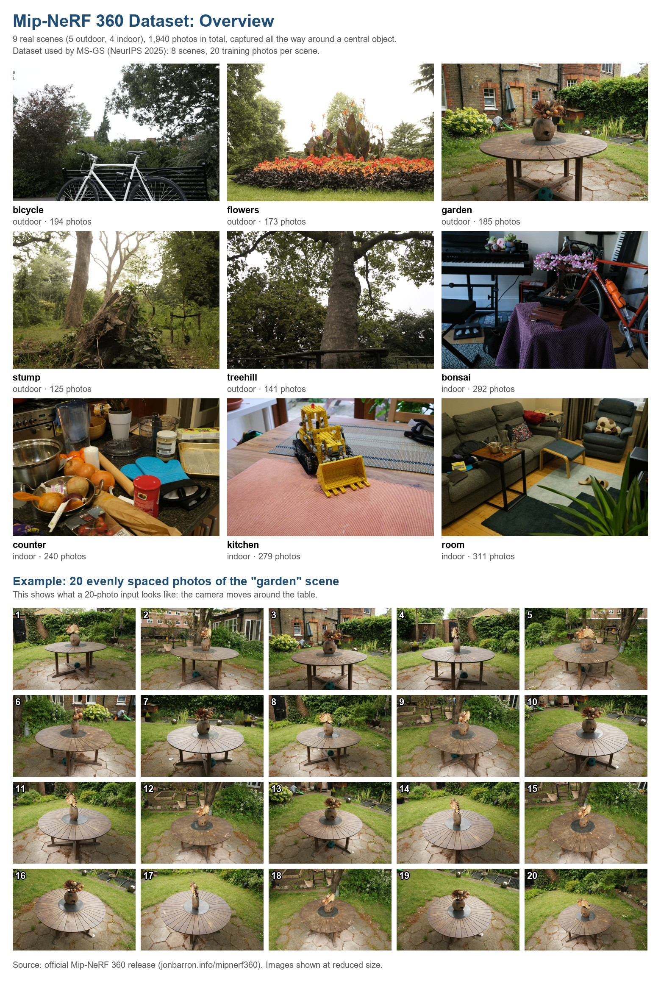
DATASET AND PROTOCOL
Mip-NeRF 360, following Free360’s setup
9 real 360° scenes, 1,940 photos (5 outdoor, 4 indoor)
8 scenes used; flowers excluded, as in Free360
Reference poses already included (COLMAP, all photos)
Test: every 8th photo · Train: 3, 6, 9 photos (training photos only)
Download: 360_v2.zip (12.5 GB) + extra scenes
Week-1 reproduction target (InstantSplat, Free360 Table 1)
Views | PSNR ↑ | SSIM ↑ | LPIPS ↓
3 | 14.10 | 0.296 | 0.529
6 | 15.83 | 0.351 | 0.480
9 | 17.16 | 0.402 | 0.443
Barron et al., CVPR 2022 · Bao et al., arXiv 2503.24382 · 11 / 15
Notes:
Mip-NeRF 360 is the standard benchmark for 360-degree scenes. It already contains COLMAP poses computed from all photos, which we use as the reference poses (very accurate, but not perfect), so we do not need to run COLMAP ourselves. We follow Free360's protocol so that our first milestone is to reproduce their published InstantSplat numbers. That checks our setup before the new experiments.

Slide 12
EVALUATION
What we will measure
Image quality
PSNR, SSIM (higher is better) and LPIPS (lower is better) on held-out test photos
Camera pose error
ATE and RPE: distance between estimated cameras and the reference cameras
Cost
Training time per scene and peak GPU memory
Visual results
Side-by-side renders and quality-vs-photos charts for each configuration
120 runs = 5 configurations × 3 view counts × 8 scenes, plus seed repeats on 2 scenes.
Sparse-View 3DGS Research Proposal · 12 / 15
Notes:
PSNR and SSIM compare pixels and structure; LPIPS uses a deep network and is closest to human judgement. ATE and RPE measure how far the cameras are from the correct ones. Measuring both image quality and pose error lets us test whether better poses really give better images. Each run takes about a minute or a few minutes, so 120 runs are realistic.

Slide 13
PRACTICAL PLAN
Tools and hardware
Software
InstantSplat (NVlabs) – base code
MASt3R, VGGT – pretrained AI models
PyTorch + CUDA 12.8 or newer
COLMAP 4.2.1 – read reference poses
LPIPS, NumPy, matplotlib – evaluation
Overleaf, Git, Claude Code – writing and code
GPU: RTX 5090, 32 GB
AI model prediction, 3DGS training, rendering. Required: CUDA only.
CPU: any computer
Data preparation, pose-error script, charts and writing.
Details: “2 - Research Proposal (Detailed).pdf”, sections 8–9 · 13 / 15
Notes:
Everything is existing, free software. The experiments must run on the RTX 5090 workstation because 3DGS training only runs on an NVIDIA GPU. A normal laptop is enough for writing and charts. The RTX 5090 is new, so it needs CUDA 12.8 or newer; this is the main setup risk.

Slide 14
PRACTICAL PLAN
Four-week timeline
WEEK 1
Setup
Install, download data, reproduce Free360 numbers on 2 scenes
WEEK 2
Implement
Add switches C1–C4 and the pose-error script; test on 1 scene
WEEK 3
Experiments
Run all 120 configurations; collect tables and images
WEEK 4
Write
Analysis, charts, paper draft, supervisor feedback
Main risk: building the CUDA code for the RTX 5090 on Windows
Fallback: Windows fork, Docker image or WSL2; setup capped at 5 days. Short on time: drop C5 and use 4 scenes.
Sparse-View 3DGS Research Proposal · 14 / 15
Notes:
The plan is realistic because we build on existing code and models. Week 1 is the critical week: if we can reproduce the published InstantSplat numbers, the rest is controlled changes and runs. We have a fallback for the setup risk and a smaller version if time runs short.

Slide 15
SUMMARY
Expected contribution and next steps
What this study gives
Which part matters most: poses, points or refinement
How this changes from 3 to 9 photos
Reusable scripts and clear visual results
An analysis study, not a new algorithm
Questions for you
Is an analysis / ablation study acceptable, or is a new method required?
Target output: course report, thesis chapter or workshop paper?
Windows setup or Linux (WSL2)?
Thank you.
Sparse-View 3DGS Research Proposal · 15 / 15
Notes:
Close with the contribution in one sentence: a controlled study that shows which part of AI-based sparse-view 3DGS really matters, and when. Then ask the three questions; the answers decide the final scope. Do not claim it is a new algorithm or completely novel: it is a new controlled analysis of an existing method.

